Slide 1

Mepco Schlenk Engineering College (Autonomous)
Role based access control with homomorphic encryption for secure data exchange in the cloud
GUIDED BY,
Mrs. P. ABINAYA
Assistant Professor (Sr. Grade)
Aakash T, 20BCS025
Jerry J A Roshan, 20BCS034
Department of Computer Science and Engineering
1

Slide 2
Mepco Schlenk Engineering College (Autonomous)
Introduction
Encryption and access control are essential security measures for protecting data in the cloud. Traditional encryption algorithms are vulnerable to attacks by quantum computers, which poses a significant threat to the security of cloud-based systems. Additionally, traditional access control systems can be complex and difficult to manage. This paper proposes a PQC-based RBAC system with OPA to address the challenges of traditional encryption and access control systems. PQC encryption is resistant to attacks by quantum computers, and OPA is a flexible and powerful policy engine that can be used to enforce fine-grained access control policies.
Department of Computer Science and Engineering
2

Slide 3
Mepco Schlenk Engineering College (Autonomous)
Problem Statement
Traditional encryption and access control systems are vulnerable to attacks by quantum computers. This is a major security risk for organizations that store and process sensitive data.
In this paper, we propose a PQC-based RBAC system with OPA to improve the security and efficiency of access control in dynamic online environments. PQC encryption is resistant to attacks by quantum computers, and OPA is a flexible and powerful policy engine.
Our system consists of a PQC encryption module, an RBAC module, and an OPA module. The PQC encryption module is responsible for encrypting and decrypting data. The RBAC module manages user roles and permissions. The OPA module makes authorization decisions based on the user's role, permissions, and other factors.
Department of Computer Science and Engineering
3

Slide 4
Mepco Schlenk Engineering College (Autonomous)
Objectives
To implement a PQC-based RBAC system with OPA for real-time authorization decisions
To improve the security and performance of access control in dynamic online environments.
Department of Computer Science and Engineering
4

Slide 5
Mepco Schlenk Engineering College (Autonomous)
Expected Outcomes
A prototype PQC-based RBAC system with OPA
A performance evaluation of the proposed system
A security analysis of the proposed system.
Department of Computer Science and Engineering
5

Slide 6
Mepco Schlenk Engineering College (Autonomous)
Literature Survey - 1
Published Year | 2020
Paper Title | Security Fault Tolerance for Access Control
Author | D. Jang, M. Shin and D. Pathirage
Description | The study uses a Security Fault Tolerance (SFT) technique. It guarantees semantic identity between the original and SFT access control by utilizing Role-Based Access Control (RBAC) and Extended Access Control List (EACL).
Limitation | The proposed system was tested on a limited number of EEG datasets, and further testing is required to validate its performance on a larger dataset. The proposed system requires a large amount of training data to achieve high accuracy, which may not be available in some cases
D. Jang, M. Shin and D. Pathirage, "Security Fault Tolerance for Access Control," 2020 IEEE International Conference on Autonomic Computing and Self-Organizing Systems Companion (ACSOS-C), Washington, DC, USA, 2020, pp. 212-217, doi: 10.1109/ACSOS-C51401.2020.00058.
Department of Computer Science and Engineering
6

Slide 7
Mepco Schlenk Engineering College (Autonomous)
Literature Survey - 2
Published Year | 2018
Paper Title | A new risk-based authentication management model oriented on user's experience
Author | M. Sepczuk, Z. Kotulski
Description | The goal of the paper is to improve user experience while preserving data security. It presents a risk-based authentication approach leveraging contextual data. The strategy uses multiple layers of authentication with a goal of achieving a balance between security levels (QoP) and user pleasure (QoE).
Limitation | The specific contextual data utilized and the adaptability of the model across diverse service environments may impact its generalizability. The paper does not extensively delve into implementation challenges or potential user-related concerns associated with the proposed risk-based authentication model.
Mariusz Sepczuk, Zbigniew Kotulski, A new risk-based authentication management model oriented on user's experience, Computers & Security, Volume 73, 2018, Pages 17-33, ISSN 0167-4048, https://doi.org/10.1016/j.cose.2017.10.002.
Department of Computer Science and Engineering
7

Slide 8
Mepco Schlenk Engineering College (Autonomous)
Literature Survey - 3
Published Year | 2020
Paper Title | Computational intelligence intrusion detection techniques in mobile cloud computing environments: Review, taxonomy, and open research issues
Author | Shahab Shamshirband, Mahdis Fathi, Anthony T. Chronopoulos, Antonio Montieri, Fabio Palumbo, Antonio Pescapè,
Description | This paper presents a comprehensive survey of intrusion detection systems (IDS) utilizing computational intelligence in mobile cloud computing (MCC) environments. Addressing the rising cyber threats to cloud-stored data, the study classifies CI-based IDS methods, offering a unique taxonomy and critically assessing previous literature. The work identifies advantages, explores limitations, and outlines open research issues, providing valuable insights for securing MCC.
Limitation | Primarily focuses on known security threats, possibly overlooking emerging ones. Generalizability of CI-based IDS methods to diverse MCC settings requires further investigation.
Shahab Shamshirband, Mahdis Fathi, Anthony T. Chronopoulos, Antonio Montieri, Fabio Palumbo, Antonio Pescapè, Computational intelligence intrusion detection techniques in mobile cloud computing environments: Review, taxonomy, and open research issues, Journal of Information Security and Applications, Volume 55, 2020, 102582, ISSN 2214-2126,https://doi.org/10.1016/j.jisa.2020.102582.
Department of Computer Science and Engineering
8

Slide 9
Mepco Schlenk Engineering College (Autonomous)
Literature Survey - 4
Published Year | 2023
Paper Title | Design of a novel privacy preservation based cyber security system framework for secure medical data transactions in cloud storage
Author | S.K.B. Sangeetha, K. Veningston, Vanlin Sathya, R. Kanthavel
Description | This chapter presents a novel Privacy Preserved Cyber Security Approach (PPCSA) to enhance the protection of medical data in cloud storage. Utilizing a unique metaheuristic method for key generation, the framework demonstrates superior cost efficiency in comparison to existing algorithms across diverse datasets.
Limitation | The framework's effectiveness relies on the chosen metaheuristic method, potentially introducing sensitivity to algorithmic variations. Evaluation on specific datasets (WHO, CDC, data.gov) may restrict the generalizability of PPCSA's performance to a broader range of medical data scenarios. The intricacies of the sanitization and restoration processes may pose challenges in real-world implementation, demanding careful consideration of computational and practical feasibility.
S.K.B. Sangeetha, K. Veningston, Vanlin Sathya, R. Kanthavel, Chapter 3 - Design of a novel privacy preservation based cyber security system framework for secure medical data transactions in cloud storage, Editor(s): D. Jude Hemanth, Brij B. Gupta, Mohamed Elhoseny, Swati Vijay Shinde, In Intelligent Data-Centric Systems, Intelligent Edge Computing for Cyber Physical Applications, Academic Press, 2023, Pages 35-43, ISBN 9780323994125, https://doi.org/10.1016/B978-0-323-99412-5.00006-X.
Department of Computer Science and Engineering
9

Slide 10
Mepco Schlenk Engineering College (Autonomous)
Literature Survey - 5
Published Year | 2019
Paper Title | A novel hybrid authentication protocol utilizing lattice-based cryptography for IoT devices in fog networks
Author | Kumar Sekhar Roy, Subhrajyoti Debb , Hemanta Kumar Kalitac
Description | The proposed algorithm includes features such as nonce and time stamp to prevent replay attacks, mutual authentication to prevent impersonation, and protection against privileged insider attacks. They also verify the security of their authentication protocol using the Automated Validation of Internet Security Protocols and Applications (AVISPA) tool.
Limitation | The proposed protocol is evaluated in a simulated environment, and its performance in a real-world scenario may differ. The proposed protocol relies on the assumption that lattice-based cryptography is secure against quantum computers, which is still an open research problem.
C. Zhang, X. P. Wu, X. Zheng, and S. Yu, "Driver drowsiness detection using multi-channel second order blind identifications," IEEE Access, vol. 7, pp. 11829-11843, Jan. 2019.
Department of Computer Science and Engineering
10

Slide 11
Mepco Schlenk Engineering College (Autonomous)
Literature Survey - 6
Published Year | 2020
Paper Title | Post-quantum cryptography for automotive systems
Author | Tim Fritzmann, Jonas Vith, Daniel Flórez, Johanna Sepúlveda
Description | The paper focuses on the investigation of PKE/KEM schemes and extends the authors' previous work on ThreeBears, an efficient second-round NIST candidate. The authors analyze four lattice-based KEM/encryption algorithms implemented on the automotive microcontroller AURIX and show that they can achieve competitive performance.
Limitation | The paper does not provide a comprehensive analysis of all post-quantum cryptography schemes, and it only focuses on a specific set of finalists and alternate candidates. The paper does not provide a detailed analysis of the performance characteristics of the investigated schemes in real-world automotive systems.
H. Yang, L. Liu,W.Min, X. Yang, and X. Xiong, “Driver yawning detection based on subtle facial action recognition,” IEEE Trans. Multimedia, vol. 23,pp. 572–583, Apr. 2020.
Department of Computer Science and Engineering
11

Slide 12
Mepco Schlenk Engineering College (Autonomous)
Literature Survey - 7
Published Year | 2022
Paper Title | Offline/Online lattice-based ciphertext policy attribute-based encryption
Author | Xingbing Fu Yinglun Wang, Lin You, Jianting Ning, Ziquan Hu and Fagen Li
Description | The authors employ the offline/online techniques to optimize attribute-based encryption. When the mobile devices are charging, the preparation work can be performed, and ABE operations can be rapidly performed on the move, which makes it significantly save the battery. The scheme uses the RLWE-based (polynomial ring) construction rather than the LWE-based (matrix) construction. The use of polynomial rings significantly reduces the time and space costs.
Limitation | Controlled Data Collection: Recorded on predefined routes, not accounting for diverse driving conditions. Limited Feature Scope: Potential insights from facial expressions and specialized driving maneuvers unexplored.
N. X. Li, J. J. Jain, and C. Busso, "Modeling of driver behavior in real world scenarios using multiple noninvasive sensors," IEEE Trans. Multimedia, vol. 15, no. 5, pp. 1213–1225, Aug. 2013.
Department of Computer Science and Engineering
12

Slide 13
Mepco Schlenk Engineering College (Autonomous)
Literature Survey - 8
Published Year | 2014
Paper Title | A hybrid elliptic curve cryptography (HECC) technique for fast encryption of data for public cloud security
Author | VaB. Ranganatha Rao, B. Sujatha
Description | The paper proposes a hybrid structure that uses lightweight elliptic curve algorithms, efficient key generation and management, and improved encryption and decryption procedures. The paper also discusses the use of a public-key infrastructure (PKI) to mitigate cloud security risks and the need for further research to evaluate the efficacy and efficiency of PKI implementations.
Limitation | further research is necessary to evaluate the effectiveness, scalability, and flexibility of multilayer algorithms for protecting various kinds of data in cloud storage, as well as to assess the viability and performance of different authentication mechanisms in massive cloud infrastructures there is a research gap in examining the reliability and scalability of the authentication mechanism in cloud systems.
V. Kazemi and J. Sullivan, "One millisecond face alignment with an ensemble of regression trees," in Proc. IEEE Conf. Comput. Vis. Pattern Recognit., Columbus, OH, USA, 2014, pp. 1867–1874.
Department of Computer Science and Engineering
13

Slide 14
Mepco Schlenk Engineering College (Autonomous)
Literature Survey - 9
Published Year | 2013
Paper Title | Handling Security issues by using homomorphic encryption in multi-cloud environment
Author | Yulliwas Ameur, Samia Bouzefranea, Le Vinh Thinh
Description | state of the art on homomorphic encryption and explores the main challenges to tackle in real applications for multi-cloud architecture. It provides a detailed description of multi-cloud computing privacy challenges using homomorphic encryption and introduces a new architecture proposed for the multi-cloud electronic medical records. The solution has been implemented using OpenFHE and DepSky.
Limitation | the paper acknowledges the challenges of applying homomorphic encryption in multi-cloud real-world applications and identifies the need toto tackle these challenges. the paper mentions that computation overhead arises as the size of the file increases.
H. B. Kang, "Various approaches for driver and driving behavior monitoring: A review," in Proc. IEEE Int. Conf. Comput. Vis., Sydney, NSW, Australia, 2013, pp. 616–623.
Department of Computer Science and Engineering
14

Slide 15
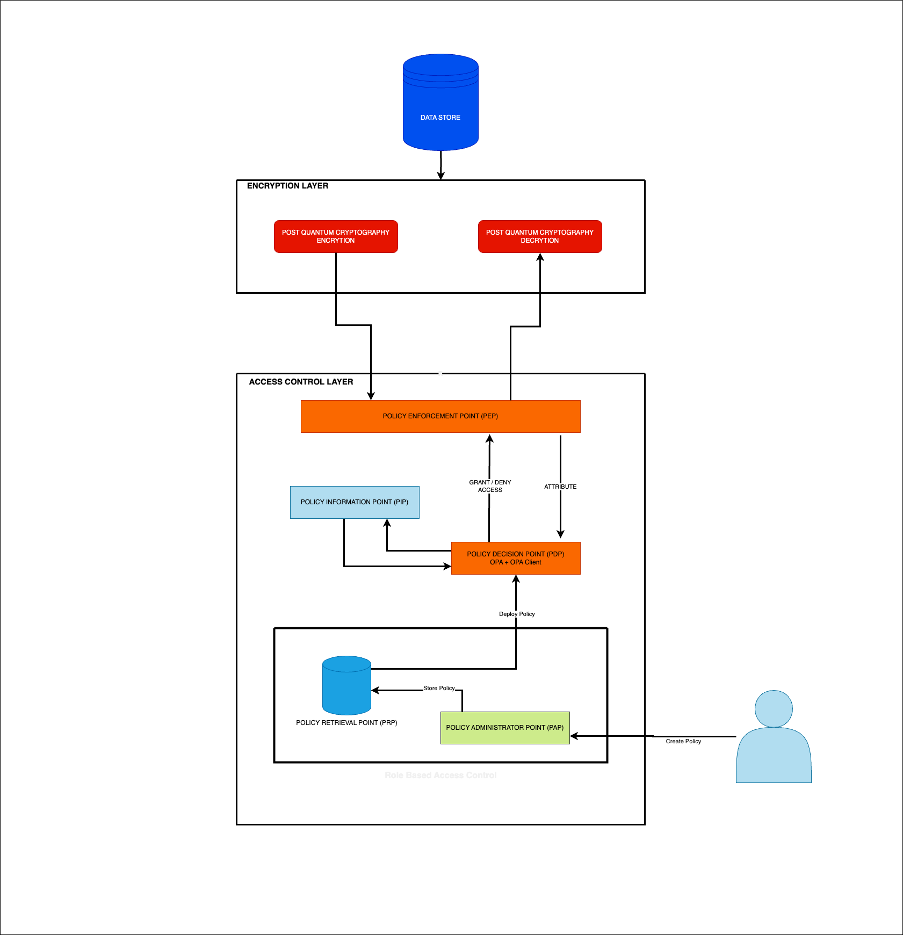
Mepco Schlenk Engineering College (Autonomous)
System design
Department of Computer Science and Engineering
15

Slide 16
Mepco Schlenk Engineering College (Autonomous)
Module Description
Module Description: PQC-based RBAC with OPA for Enhanced Security
Input: PQC encryption algorithm, OPA policy engine, user roles and permissions
Output: A secure and efficient access control system
Description:
The PQC-based RBAC with OPA module is a secure and efficient access control system that uses post-quantum cryptography (PQC) and the Open Policy Agent (OPA) policy engine to enforce fine-grained access control policies.
PQC encryption is resistant to attacks by quantum computers, which makes it ideal for protecting data in cloud and distributed systems. OPA is a flexible and powerful policy engine that can be used to write and enforce complex access control policies in a declarative manner.
Department of Computer Science and Engineering
16

Slide 17
Mepco Schlenk Engineering College (Autonomous)
The PQC-based RBAC with OPA module consists of the following components:
PQC encryption module: This module is responsible for encrypting and decrypting data using a PQC encryption algorithm.
RBAC module: This module manages user roles and permissions.
OPA module: This module makes authorization decisions based on the user's role, permissions, and other factors.
To use the PQC-based RBAC with OPA module:
configure the PQC encryption module and the OPA module.
define the user roles and permissions that you want to use.
write OPA policies to enforce the desired access control rules.
Department of Computer Science and Engineering
17

Slide 18
Mepco Schlenk Engineering College (Autonomous)
The PQC-based RBAC with OPA module offers a number of benefits, including:
Improved security: PQC encryption is resistant to attacks by quantum computers, and OPA provides a number of security features, such as policy validation and policy testing.
Increased efficiency: OPA can make authorization decisions in real time, which can improve the performance of applications.
Reduced complexity: OPA is a declarative policy engine, which means that policies can be written in a human-readable format. This can simplify the management of access control policies.
Department of Computer Science and Engineering
18

Slide 19
Mepco Schlenk Engineering College (Autonomous)
NTRU Encrypt Key Generation:
Input: No specific input required for key generation.
Output: Public key h(x) and private key (f(x),g(x)).
Parameter Selection:
Choose parameters for the NTRU Encrypt scheme, such as the degree of the polynomial, the number of coefficients, and other relevant parameters.
2. Key Generation:
Generate two sets of random polynomials, f(x) and g(x), with specific properties based on the chosen parameters.
3. Public and Private Key:
The public key is generated as
h(x)=f(x)⋅g(x)mod q
where q is a modulus. The private key is (f(x),g(x)).
Department of Computer Science and Engineering
19

Slide 20
Mepco Schlenk Engineering College (Autonomous)
NTRUEncrypt Encryption:
Input: Recipient's public key h(x), Plaintext message m.
Output: Ciphertext c(x).
Parameters: Public key parameters, such as h(x) and modulus q.
Select Recipient's Public Key:
Obtain the recipient's public key h(x).
2. Message Encoding:
Encode the plaintext message mm into a polynomial m(x).
3. Error Polynomial:
Generate a small polynomial e(x) with coefficients from a small set, adding this to m(x) to form m(x)+e(x) .
Cipher Polynomial:
Compute the cipher polynomial c(x)=(3m(x)+e(x))mod q.
Ciphertext:
Send c(x) as the ciphertext to the recipient.
Department of Computer Science and Engineering
20

Slide 21
Mepco Schlenk Engineering College (Autonomous)
NTRUEncrypt Decryption:
Input: Ciphertext c(x), Recipient's private key (f(x),g(x)).
Output: Decrypted plaintext message mm.
Parameters: Private key parameters, such as (f(x),g(x)), and modulus q.
Private Key Retrieval:
Retrieve the private key (f(x),g(x)) corresponding to the recipient's public key.
2. Polynomial Computations:
Compute c1(x)=c(x)⋅f(x)mod q and c2(x)=c1(x)mod p, where p is another modulus.
3. Decoded Message:
Decode c2(x) to retrieve the original message polynomial m(x).
4. Error Recovery:
Recover the error polynomial e(x) by subtracting 3m(x)mod q from c(x).
5. Original Message:
Obtain the original message mm by decoding m(x).
Department of Computer Science and Engineering
21

Slide 22
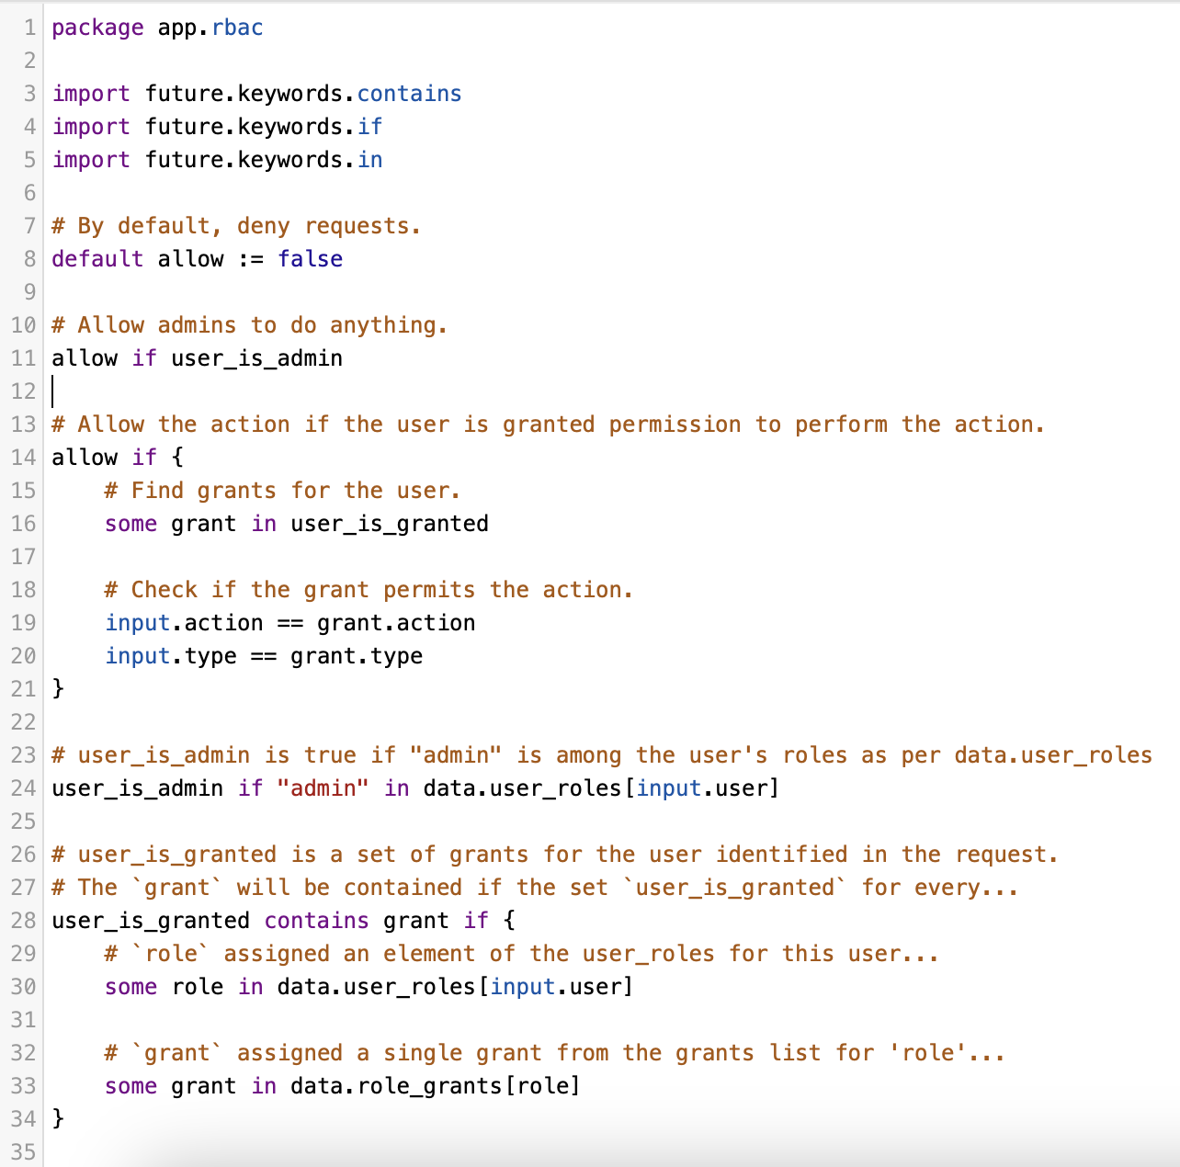
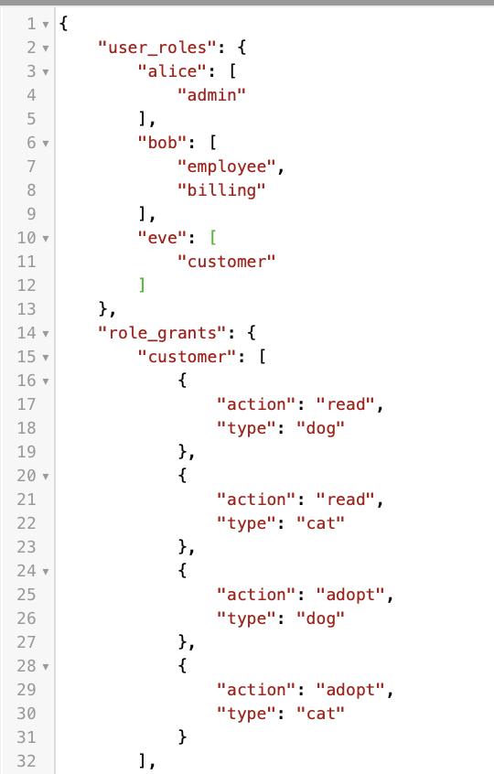
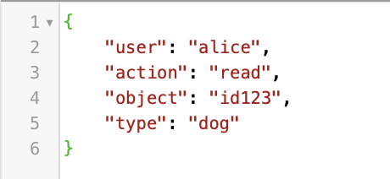
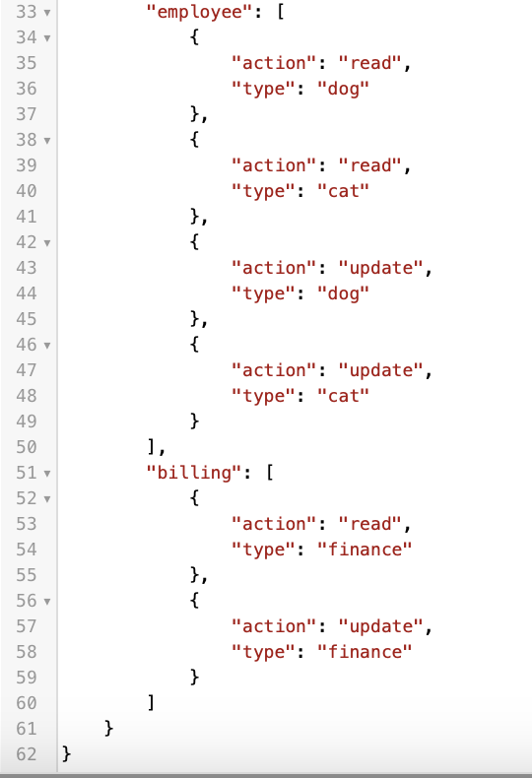
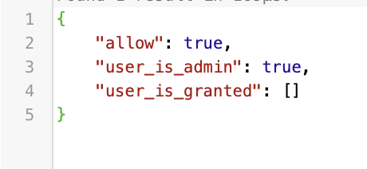
Mepco Schlenk Engineering College (Autonomous)
Implementation results and discussion
Data
RBAC in OPA:
Input
Output
Department of Computer Science and Engineering
22

Slide 23
Mepco Schlenk Engineering College (Autonomous)
Work(s) completed so far
OPA with RBAC Integration
Work(s) yet to complete
PQC Implementation.
PQC based RSA Integration.
Department of Computer Science and Engineering
23

Slide 24
Mepco Schlenk Engineering College (Autonomous)
REFERENCES
A. Kousalya, Nam-kyun Baik, ”Enhance cloud security and effectiveness using improved RSA-based RBAC with XACML technique”, International Journal of Intelligent Networks, Volume 4, 2023, Pages 62-67, ISSN 2666-6030, https://doi.org/10.1016/j.ijin.2023.03.003.
D. Jang, M. Shin and D. Pathirage, "Security Fault Tolerance for Access Control," 2020 IEEE International Conference on Autonomic Computing and Self-Organizing Systems Companion (ACSOS-C), Washington, DC, USA, 2020, pp. 212-217, doi: 10.1109/ACSOS-C51401.2020.00058.
Mariusz Sepczuk, Zbigniew Kotulski, A new risk-based authentication management model oriented on user's experience, Computers & Security, Volume 73, 2018, Pages 17-33, ISSN 0167-4048, https://doi.org/10.1016/j.cose.2017.10.002.
Shahab Shamshirband, Mahdis Fathi, Anthony T. Chronopoulos, Antonio Montieri, Fabio Palumbo, Antonio Pescapè, Computational intelligence intrusion detection techniques in mobile cloud computing environments: Review, taxonomy, and open research issues, Journal of Information Security and Applications, Volume 55, 2020, 102582, ISSN 2214-2126,https://doi.org/10.1016/j.jisa.2020.102582.
Department of Computer Science and Engineering
24

Slide 25
Mepco Schlenk Engineering College (Autonomous)
S.K.B. Sangeetha, K. Veningston, Vanlin Sathya, R. Kanthavel, Chapter 3 - Design of a novel privacy preservation based cyber security system framework for secure medical data transactions in cloud storage, Editor(s): D. Jude Hemanth, Brij B. Gupta, Mohamed Elhoseny, Swati Vijay Shinde, In Intelligent Data-Centric Systems, Intelligent Edge Computing for Cyber Physical Applications, Academic Press, 2023, Pages 35-43, ISBN 9780323994125, https://doi.org/10.1016/B978-0-323-99412-5.00006-X.
I. H. Choi, C. H. Jeong, and Y. G. Kim, “Tracking a driver’s face againstextreme head poses and inference of drowsiness using a hidden Markovmodel,” Appl. Sci.-Basel, vol. 6, no. 5, May 2016
C. Zhang, X. P. Wu, X. Zheng, and S. Yu, “Driver drowsiness detection us_x0002_ing multi-channel second order blind identifications,” IEEE Access, vol. 7,pp. 11829–11843, Jan. 2019.
H. Yang, L. Liu,W.Min, X. Yang, and X. Xiong, “Driver yawning detection based on subtle facial action recognition,” IEEE Trans. Multimedia, vol. 23,pp. 572–583, Apr. 2020.
N. X. Li, J. J. Jain, and C. Busso, “Modeling of driver behavior in real world scenarios using multiple noninvasive sensors,” IEEE Trans. Multimedia,vol. 15, no. 5, pp. 1213–1225, Aug. 2013.
M. Omidyeganeh, S. Shirmohammadi, S. Abtahi, A. Khurshid, and L.Martel, “Yawning detection using embedded smart cameras,” IEEE Trans.Instrum. Meas., vol. 65, no. 3, pp. 570–582, Mar. 2016.
H. B. Kang, “Various approaches for driver and driving behavior moni_x0002_toring: A review,” in Proc IEEE Int. Conf. Comput. Vis., Sydney, NSW,Australia, 2013, pp. 616–623
Department of Computer Science and Engineering
25

Slide 26
Mepco Schlenk Engineering College (Autonomous)
THANK YOU
Department of Computer Science and Engineering
26

